Slide 1
Diabetes Sector Group Priorities & Activities
30 November 2022

Slide 2
MTE Diabetes Sector Group
Priorities & Activities
Who we are & what we do
Advancing the Digital Transformation of Diabetes Care
Engaging on Type 2 Diabetes
The EU Non-Communicable Disease lnitiative & Joint Action on CVDs and Diabetes
Our Partnerships

Slide 3
Who we are & what we do
Advancing the Digital Transformation of Diabetes Care
Engaging on Type 2 Diabetes
The EU Non-Communicable Disease lnitiative & Joint Action on CVDs and Diabetes
Our Partnerships

Slide 4
Diabetes Sector Group: Who we are
The Diabetes Sector Group at MedTech Europe brings together diabetes technology companies to champion people with diabetes, their advocates and healthcare professionals for the best choices to prevent, manage and ultimately cure diabetes
Raise awareness around diabetes prevention and care
Advance the digital transformation of diabetes treatment and care
Enhance treatment and care for people living with Type 1 and Type 2 diabetes
Champion value-based healthcare to improve quality of life and cut long-term costs
Be a trusted partner in the diabetes environment
Key priorities

Slide 5
Company representatives in the Diabetes Sector Group
Business Leaders
Ambassadors
Company | BL Name | Responsibility
 | Ansgar Resch | Divisional Vice President Diabetes Care, EMEA
 | Torstein Myhre | Head of Region Europe and Canada
 | Alex Moussa | SVP & General Manager EMEA
 | Slobodan Radumilo | Vice President / General Manager Medical Diabetes Care Europe & EMEA
 | Robert Swanborough | General Manager, EMEA
 | Stuart Morton | Vice President, EMEA
 | Federico Gavioli | Vice President Diabetes, EMEA
 | Andreas Altemark | Head of Global Market Access
Ambassadors Name | Responsibility
Fleur Levrat | Global Market Access Manager, EMEA
TBD | TBD
Adrian Gut | Director Government Affairs, EMEA | Dexcom
Katerina Zakrzewska | Head of Market Access & Pricing Diabetes Care Europe
Melanie Littlewood | Senior Director, Value and Access, International
Joyce Van Hoeck | EMEA Market Access Lead
Simona De Portu | Head of Market Access and GA Diabetes EMEA region
Heather Mikulski | Global Policy and Engagement Lead
Notes:
Please look up original structure slide. It was a bit different. E.g. big ideas were linked to business leaders, not to ambassadors.
For the Budget: only mention the annual financial contribution (2015-16: 10K, 2017-20: 15K, 2021: 25K), not the whole list.

Slide 6
Who we are & what we do
Advancing the Digital Transformation of Diabetes Care
Engaging on Type 2 Diabetes
The EU Non-Communicable Disease lnitiative & Joint Action on CVDs and Diabetes
Our Partnerships

Slide 7
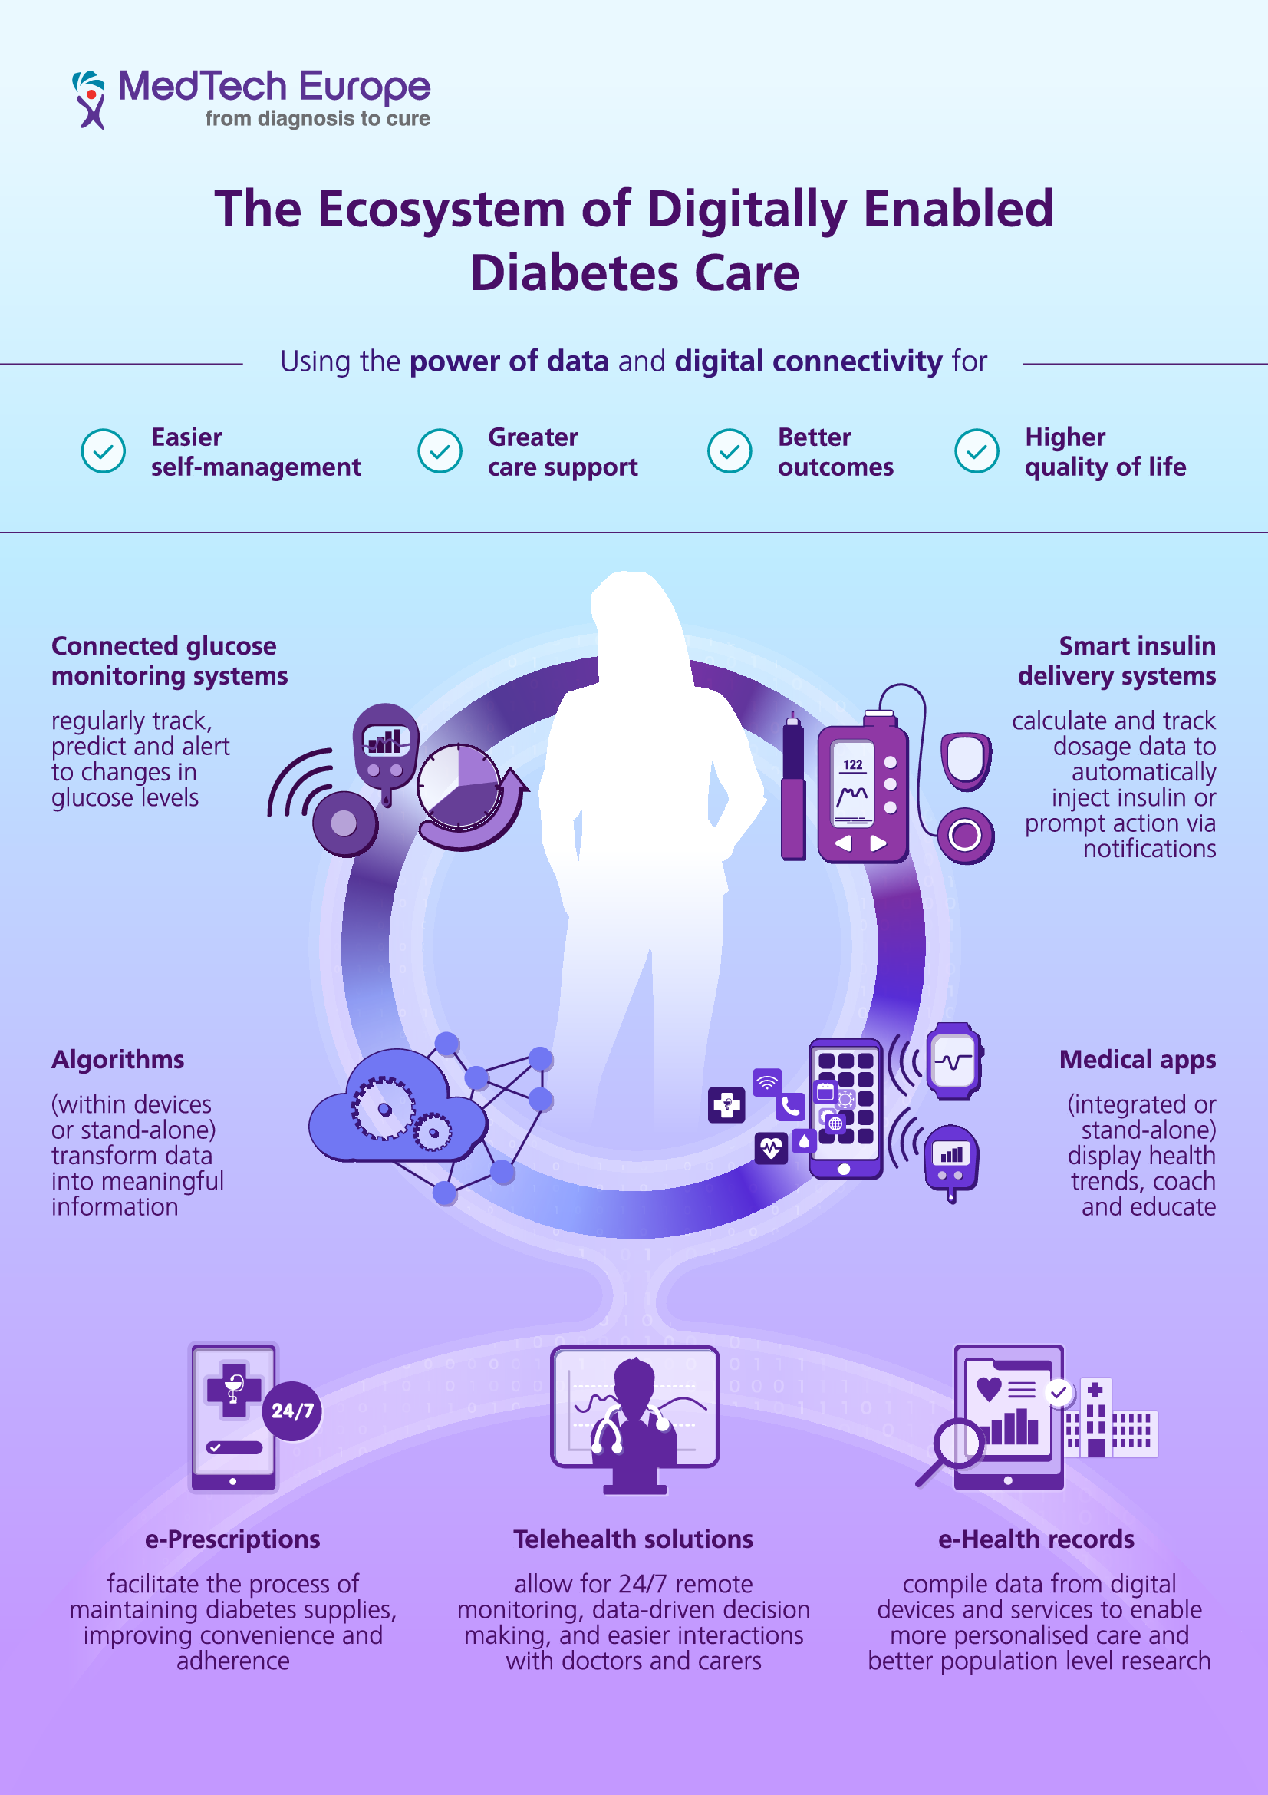
Advancing the Transformation of Diabetes Care (1): The Digital Ecosystem
The group developed an infographic defining
’The Ecosystem of Digitally Enabled Diabetes Care’
Three objectives:
Define a blurry concept
Raise awareness with non-experts
Reinforce the value of digital enabled medical technologies
Core elements:
A people-centric concept
Four value dimensions
Four core categories
Data flow and digital connectivity
Very positive acknowledgement by medtech community and diabetes stakeholders!
Available in EN, FR, ES, IT, DE, NL

Slide 8
Advancing the Transformation of Diabetes Care (2): A Vision for Digitally Enabled Diabetes Care
2020 Review
The group commissioned a vision paper on ‘digitally enabled diabetes care’ exploring key trends, challenges and solutions for the future (2020)
Co-authorship with Prof. J. Nolan and T. Valentin
Interviews and input by 20 leading KOLs in diabetes
The paper was discussed in two webinars:
Panels of scientific and political KOLs and patient voices
Testing vision vs real-life with national examples
Vision paper available in English and Spanish
Recordings of webinars 1 and 2 are available here
Notes:
Can we get figures from our MTE website which are more up to date?
Pictures: can we have more pictures: e.g. SM banners, white paper or so?

Slide 9
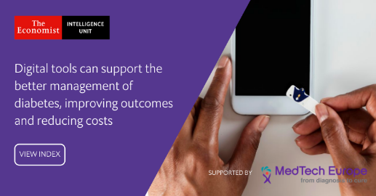
Advancing the Transformation of Diabetes Care (3): The Digital Diabetes Index
2020 Review
Research project with the ‘Economist Intelligence Unit’ in 2020:
The EIU developed a three-level-framework to define the ‘digital readiness of healthcare systems’
The index is based on 25 indicators:
digital readiness in general
digital readiness in diabetes
incentives for use of digital diabetes tools
The index was deployed to 10 EU countries to assess their digital readiness in diabetes care
The research comprises of three parts that can be downloaded here:
Index with indicators
Outcome report with recommendations
Country profiles
Notes:
Can we get figures from our MTE website which are more up to date?
Pictures: can we have more pictures: e.g. SM banners, white paper or so?

Slide 10
Advancing the Transformation of Diabetes Care (4): National Advances
Spotlight on CGM advances
Belgium: 7 million EUR will be made available for CGM sensors for T2D provided by the government in 2023
USA: Medicare coverage for CGM for T2D has widened progressively over the past several years, including the 2021 removal of the 4-time-daily finger sticks condition for eligibility: CGM coverage is in the process of further expanding, e.g, for people using basal insulin only (or no insulin at all, but who experience levels of hypoglycemia).
Telemonitoring (France)
France: The ETAPES program, which encourages and financially supports the deployment of remote monitoring projects, was extended through 2023; based on the programme’s success, a reimbursement and funding framework for RPM will be put into law end of 2022.
Health Apps
Belgium: introduced an app categorisation platform for mobile health, for mobile apps that are CE-marked as a medical device
Germany: The Digital Healthcare Act (DiGA) in 2019 introduced the “app on prescription” as part of healthcare provided to patients. 73 million insured patients are entitled to healthcare through digital health applications.

Slide 11
Who we are & what we do
Advancing the Digital Transformation of Diabetes Care
Engaging on Type 2 Diabetes
The EU Non-Communicable Disease lnitiative & Joint Action on CVDs and Diabetes
Our Partnerships

Slide 12
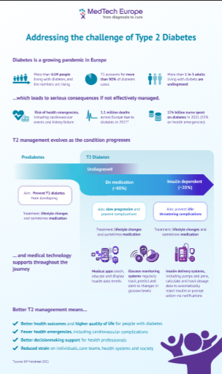
Engaging on Type 2 Diabetes: New Material
The group has developed for external use:
(1) A core position
(2) Infographic
Core elements:
The prevalence & challenge of T2D
Pathway of people with T2D
Role of medical technologies
Type 2 diabetes paper
Infographic

Slide 13
Who we are & what we do
Advancing the Digital Transformation of Diabetes Care
Engaging on Type 2 Diabetes
The EU Non-Communicable Disease lnitiative & Joint Action on CVDs and Diabetes
Our Partnerships

Slide 14
EU NCD “Healthier Together” Initiative: Promoting Focus Digitally Enabled Diabetes Care
Launched in December 2021 by the European
Aims at reducing the burden of five chronic conditions, including diabetes
The MTE Diabetes Group provided input jointly with all diabetes partners (IDF Europe, EUDF) on themes to be focused on
The Group’s priorities of self-management through digitally enabled care are reflected in the future work packages of the EU NCD initiative
MTE Diabetes Group submission to EU NCD initiative (April 2022)
European Commission Roadmap on the EU NCD (June 2022)

Slide 15
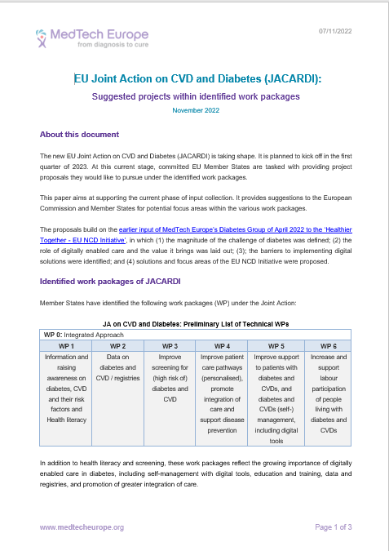
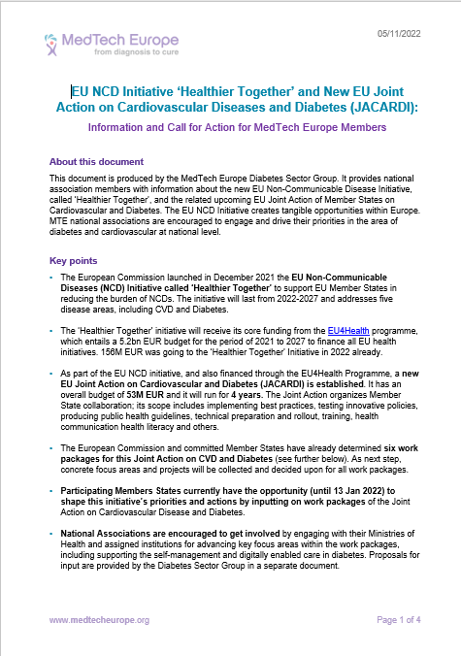
EU NCD “Healthier Together” Initiative: Member State Joint Action on CVDs and Diabetes (JACARDI)
21 EU member states collaborate for 4 yrs (2023-2026), 53 Mio EUR budget
Six work packages:
Awareness raising / health literacy
Data / registries
Screening
(Integrated) care pathways
(Self-) management & digital tools
Labor participation
MTE Diabetes Group:
Members’ briefing on Joint Action (internal)
Input on topics per work package
Information and intelligence sharing
(EUDF, CVD Group, National Ass, etc.)
Input on topics for Joint Action (07 Nov 2022)
Members’ briefing
(05 Nov 202”)
Collaboration with National Associations & Country Teams desired!

Slide 16
Who we are & what we do
Advancing the Digital Transformation of Diabetes Care
Engaging on Type 2 Diabetes
The EU Non-Communicable Disease lnitiative & Joint Action on CVDs and Diabetes
Our Partnerships

Slide 17
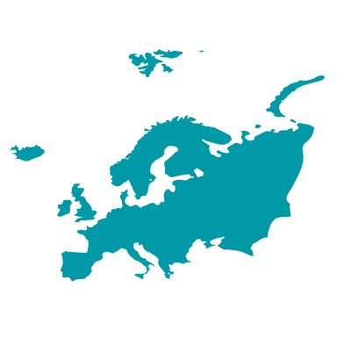
Our Partnerships
2021-3 Strategy
National Associations
International Conference on Advanced Technologies and Treatments of Diabetes (ATTD)
MTE’s engagement: strong historic relationship with ATTD
Sponsorship of start-up grants at New Tech Fair since its founding; now a cornerstone of the conference
Grant support for website and educational portal
Multistakeholder diabetes forum that unites diabetes stakeholders in Europe for a shared voice to achieve policy results (MTE member since 2021)
MTE’s engagement: works across 3 strategic forums (registries, self-care and digital, integrated care), the EUDF policy network and EUDF board
National Associations across the EU that include a focus on diabetes
MTE’s engagement: support and collaboration in areas where useful
Sharing and translating material
Updating on developments, learnings and best practices
Connecting on shared country and EU-level priorities

Slide 18
Our Partnerships: European Diabetes Forum (EUDF)
This multi-stakeholder European diabetes forum kicked off in 2020
Aims to unite diabetes stakeholders speak with one voice and achieve policy results
Our group joined January 2021, identifying an opportunity to provide knowledge and valuable input from the medical technology sector on key discussions and initiatives
We actively engage, including through strategic forum research and discussions, content development, webinars, and Policy Network support, including on the EU NCD initiative
Forum
With full members, associate members, supporting collaborators &
National Diabetes Forums + Policy Network
1
2
3
3 Strategic Forums
Chaired by Experts
Self-care, Technology Digitalization
Data & Registries
Integrated
Care
Board
Executive Director

Slide 19
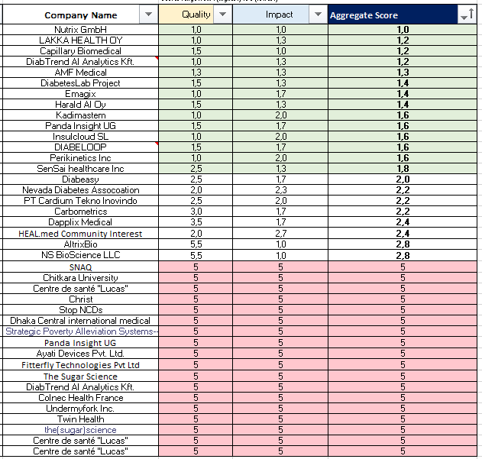
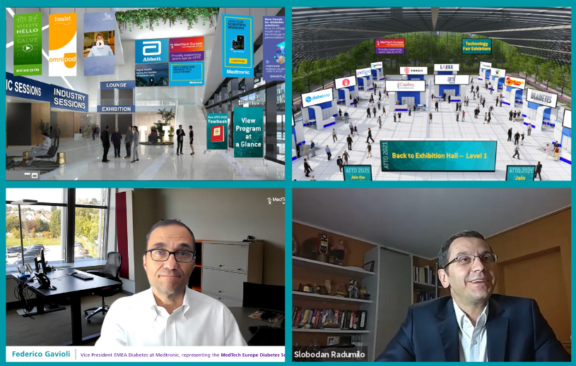
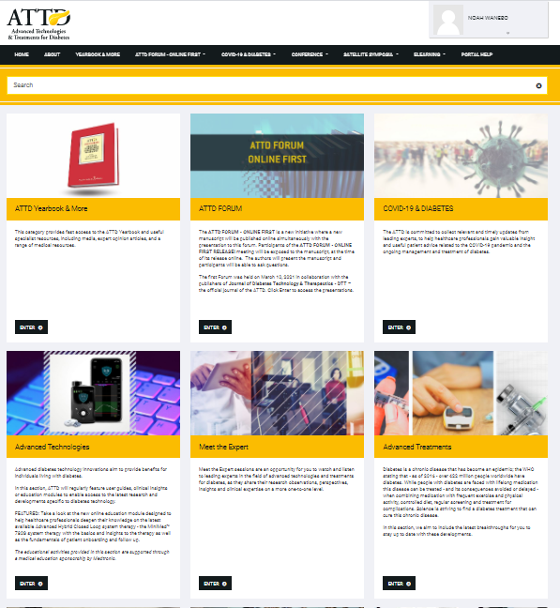
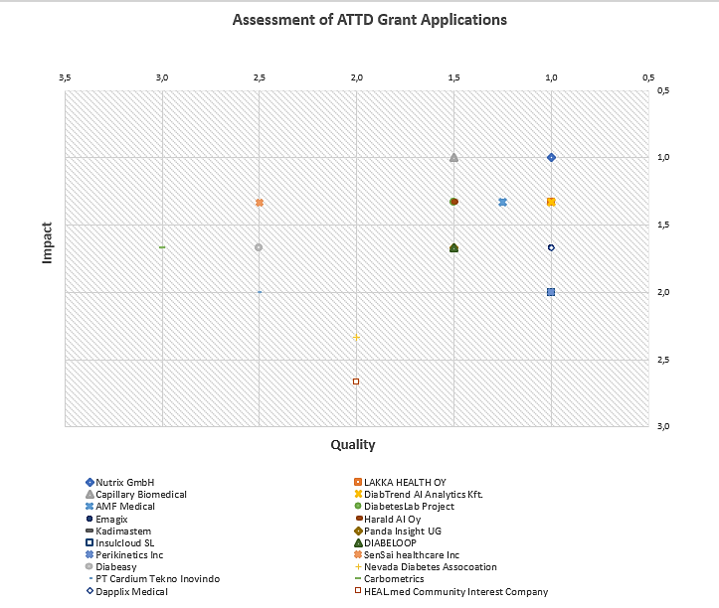
Our Partnerships: ATTD
Assessment of start-up grant applications based on criteria developed for the Diabetes Sector Group
Conference speaking engagements
MTE visibility throughout the conference
Visibility on the ATTD Education Portal with remaining funds from the start-up grants

Slide 20
Our Partnerships: National Association Collaboration
Objective: National level decisionmakers understand the importance – and set incentives for the uptake -- of digitally enabled care and a value-based approach to healthcare, including for T2
Approach: Continue supporting country-level engagement in the following ways:
Support with input into key country developments
Interoperability (in Germany and beyond), updates and collaboration with MTE (e.g, IWG and BVMed on the development of MIOs in in Q1-Q2 2022)
Evolving reimbursement programmes (post-ETAPES, BE Pyramid; DiGA)
Increase engagement with priority countries
Identify opportunities to bring Value programme and T2 content in-country (NAMs or via collaboration with EUDF) to take case to policymakers
Explore potential national pilot project with EUDF to bring value narrative to country-level decisionmakers (linked to EU NCD Initiative)
France
Germany
Italy
UK
Germany
Slovenia
Sweden
UK
Spain
Austria
Belgium

Slide 21
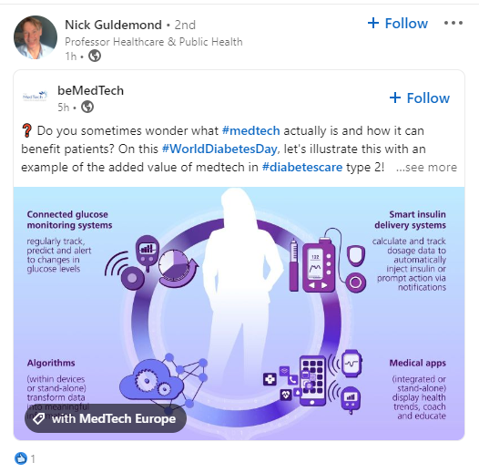
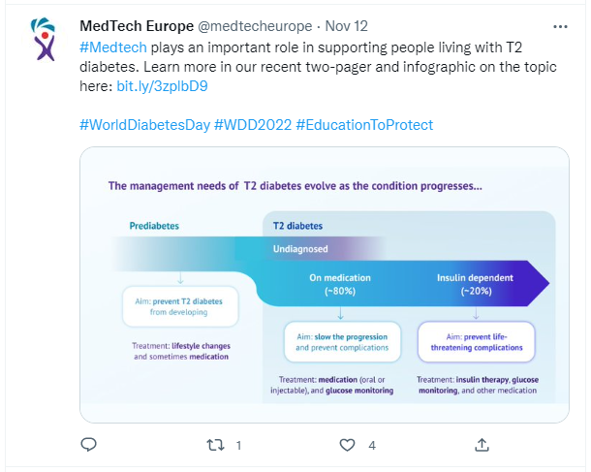
World Diabetes Day
The Group produced a social campaign for World Diabetes Day that :
supported the Global campaign of the International Diabetes Federation (IDF)
amplified key priorities and messaging
Collaborated with National Association colleagues
Example messages
Type 2 #diabetes is a progressive condition that can lead to serious health consequences if not effectively managed. Learn how #medtech supports in the management journey here: https://bit.ly/3DczPyD #WDD2022 #EducationToProtect
More than 90% of #diabetes care is self-care. Learn how digitally enabled medical technologies empower people living with T1 and T2 diabetes to better manage the condition, improving health outcomes and quality of life. ➡️https://bit.ly/3a2zZKS #WDD2022 #EducationToProtect
Today is #WorldDiabetesDay. The medical technology industry supports people living with diabetes and stands in solidarity with the entire diabetes community. #WDD2022 #EducationToProtect

Slide 22
Thank you!
MedTech Europe Diabetes Group
Tanja Valentin
t.valentin@medtecheurope.org
GSM: +32 493 518 005
https://www.medtecheurope.org/diabetes/

